Slide 1

Chapters 12 and 14

Slide 2
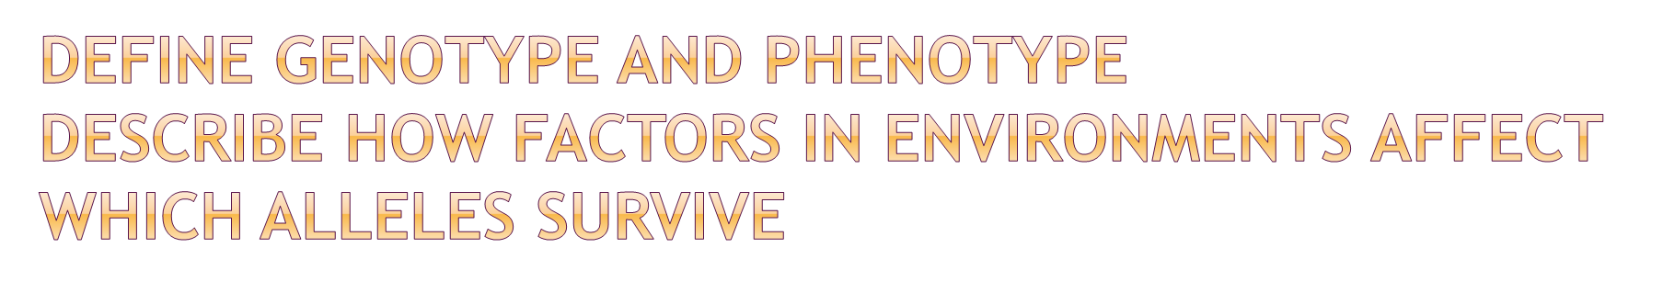
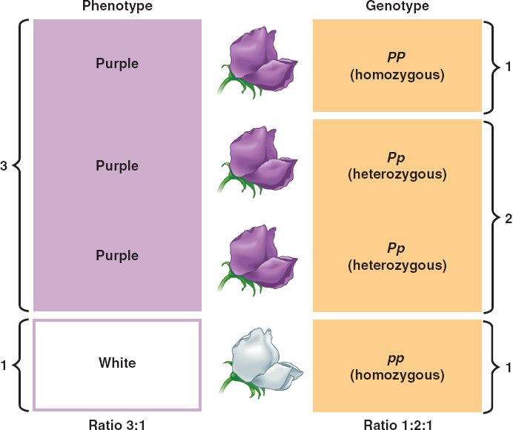
Genotype refers to the set of genes in our DNA responsible for a particular trait, phenotype refers to the observable characteristics that arise from the genotypes found in our DNA.
Knowing how characterisitcs occur in a population often allow geneticists to determine the allele frequencies.
Frequencies can be affected by a variety of factors
including mutations, natural selections, genetic drift
and gene flow.

Slide 3
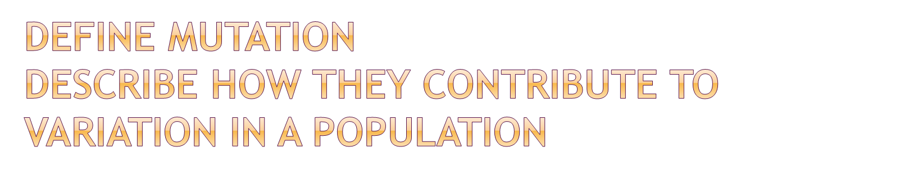
A mutation is a change in gene or chromosome leading to new characteristics in an organism.
A mutant is the organism which displays a characteristic derived from a mutation
A mutagenic agent is an environmental agent that increases the rate of mutation
Mutations contribute to variation in a population as they cause new characteristics to be formed.

Slide 4
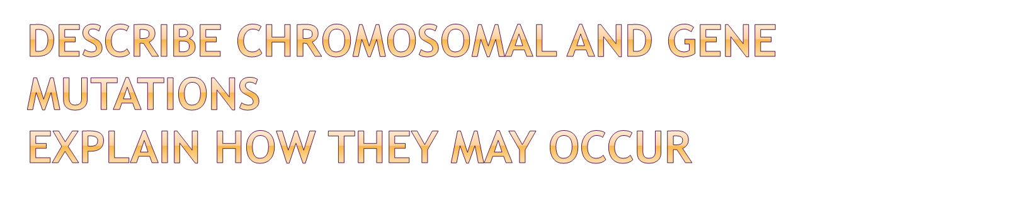
Gene mutations are changes to a single gene so that the traits normally presented by that gene or changed or destroyed. Chromosomal mutations occur where part or all of the chromosome is affected.
Gene mutations occur when DNA is replicated before division. The mistake may be corrected but if not, the cell will divide and copy the mistake to its daughter cells.
Chromosomal mutations cause abnormalities so severe that miscarriages often occur during pregnancy.

Slide 5

Deletion- when part of a chromosome is lost
Duplication-a section of chromosome occurs twice; may occur when part of a chromatid breaks off and joins the wrong chromatid
Inversion- when a broken piece of the chromosome joins back onto the chromatid the wrong way around thus changing the order of genes, disrupting the pairing of homologous chromosomes
Translocation-part of a chromosome breaks off and is re-joined to the wrong chromosome
Non-disjunction – when a chromosome pair does not separate, resulting in one daughter cell having an extra chromosome and another having one less than normal. (may be referred to as Aneuploidy).

Slide 6

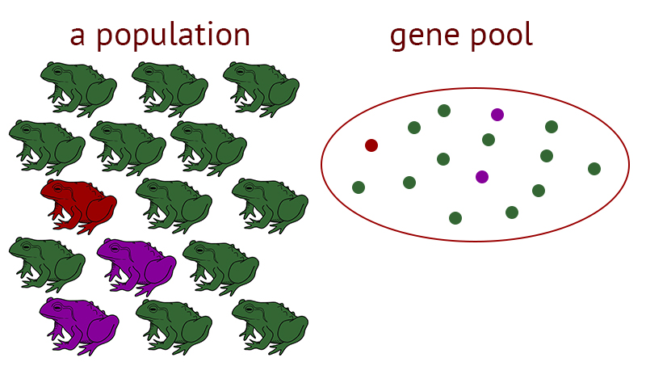
A gene pool is the sum of all alleles in a population
Gene pools allow for genetic diversity in a population to be identified. We can use gene pools to compare frequencies of various alleles in different locations and at different time periods.

Slide 7
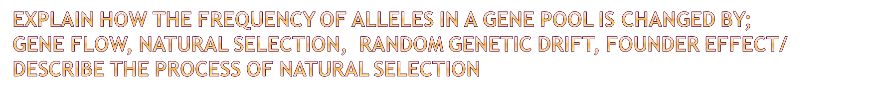
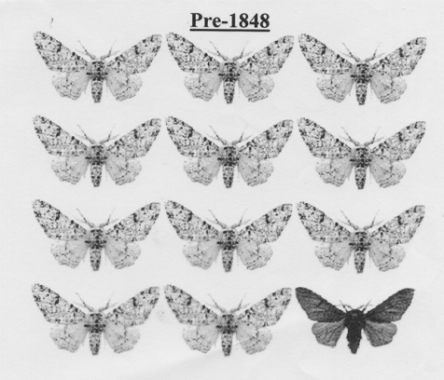
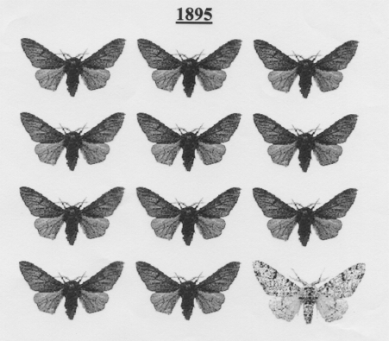
Natural selection:
In any population, there is variation between individuals. Some differences result from either gene mutations (changes to the DNA code) or chromosomal mutations (changes to the number or structure of whole chromosomes).
There are more individuals than there are resources (food, water, shelter) to support them. This causes a struggle for existence.
Variation between individuals means that some individuals are more likely than others to survive long enough to reproduce (survival of the fittest). These individuals are said to be “fitter” or “better adapted to their environment”.
The fittest individuals are more likely to survive, reproduce and pass their characteristics on to the next generation. Thus, these favourable characteristics will become more common.

Slide 8
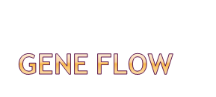
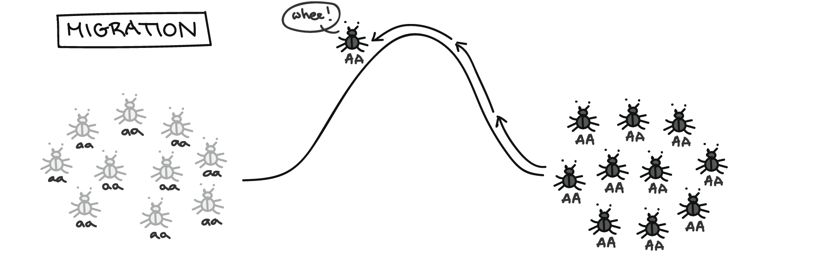
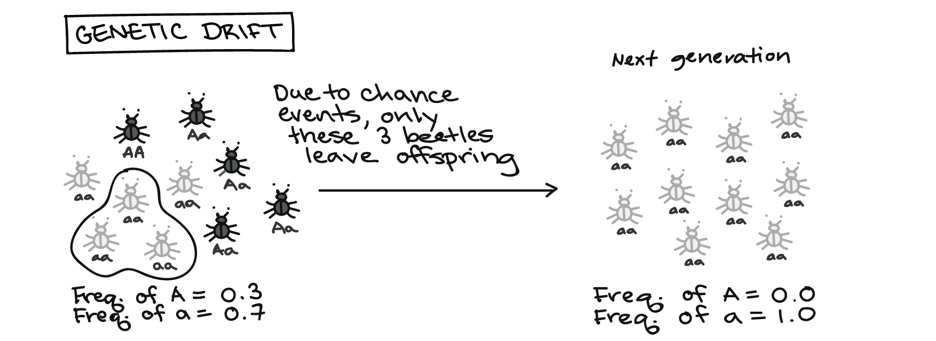
When people add new alleles to a population or remove currently existing alleles, altering the gene pool.
Genetic drift
Occurs in small populations and results, by chance, in increases or decreases in allele frequencies.

Slide 9

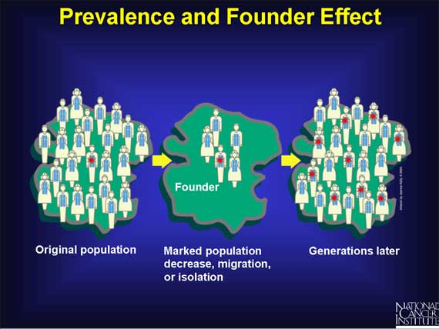
A variation of genetic drift but occurs when the a small population has become isolated from the original population and by chance, their allele frequencies do not reflect the gene pool of the original large population. The small population begins to grow, retaining their frequencies, maintaining the differences to the original population. Isolation can be cultural or geographical.

Slide 10

Darker skin towards the equator vs lighter skin further away from the equator: dark skin protects from UV rays therefore is advantageous in climates with higher amounts of UV radiation; selective advantage therefore increased frequency close to the equator.
Eskimos are shorter, stockier individuals as this reduces the surface area of skin, resulting in less heat loss. This is a survival advantage in colder climates and thus causes an increase in allele frequency.

Slide 11
 | Tay-sachs | Sickle-cell anameia | Thalasemia
Cause | Loss of enzyme responsible for break down of fatty acid substance | Mutation of gene responsible for production of red blood cell production | Mutation of gene responsible for red blood cell / haemoglobin production
Symptoms | Build up of fatty acids in nervous system Physical disabilities (blindness, deafness, inability to speak). | Fatigue/ anaemia/ shortness of breath Sickel shape of RBC’s Reduced oxygen carrying abilities | Abnormal shaped haemoglobin Fewer functioning RBC’s Anaemia/ Irondeficiency / bone malformations
Population affected | Jewish population | African Americans | Mediterranean/Greek/ Italian
Inheritance | Recessive | Recessive | Recessive
Effect on gene pool | Homozygous- usually die early Heterozygous- resistance to tuberculosis | Homozygous-can be fatal/ cause early death Heterozygous- resistance to malaria | Homozygous- mild case 1-2 mutaions, 3-4 mutations causes increased likelihood of fatality Heterozygous -resistance to malaria.

Slide 12
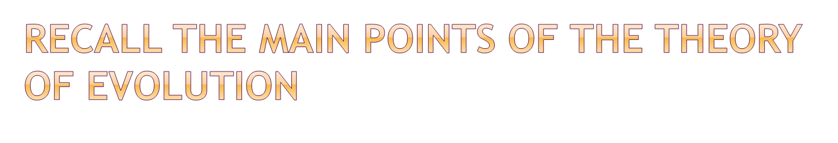
Evolution refers to the gradual change in characteristics of a species.
The three observations made to conclude the theory of evolution were:
Variation exists within populations
Living organisms reproduce at a rate much larger than the rate at which the amount food and other supplies increase
Although birth rate is high, the number of individuals within a species would remain relatively constant

Slide 13
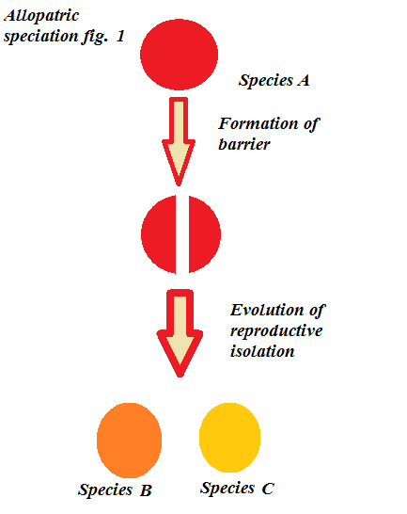

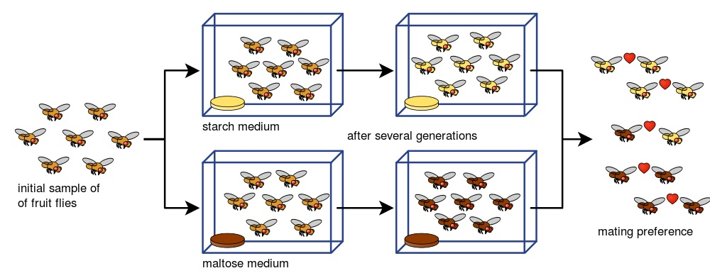
Variation exists in a population
A barrier divides the population (sociocultural or geographical).
Different selective pressures result in different alleles being favoured. The frequencies of these allels will thus change
After various generations, the divisions are so genetically different that they can no longer interbreed and are thus classified as two different species.

